Slide 1

HOUSE PRICE PREDICTION
GROUP NO:- G13
ENROLLMENT NO:- 20BECE30023 DHRUVI DALAL
20BECE30031 VANSHIL DETROJA
20BECE30034 KHUSHI MODI
20BECE30068 PARTH PANCHOLI
GUIDED BY:- PROF. DHARMESH TANK

Slide 2





OUTLINE
Introduction
Technology used
Tools used
How it works?
What it does?
Output

Slide 3
INTRODUCTION
In this project, we have built a machine learning model to predict the house price of a locality.
This project will very helpful for the real estate market.
Multiple linear regression algorithm is used to create a model with a great accuracy score.

Slide 4
TECHNOLOGY USED:
TECHNOLOGIES USED FOR BACKEND
MACHINE LEARNING
PYTHON
TECHNOLOGIES USED FOR FORTENED
FLASK & WREKZUEG
HTML
CSS
JS

Slide 5
Machine learning problem can be classified as :
Machine Learning : It’s a subfield of AI that allows to predict most accurate outcomes using algorithms.
SUPERVISED LEARNING
Supervised machine learning is generally used to classify data or make predictions, whereas unsupervised learning is generally used to understand relationships within datasets.
UNSUPERVISED LEARNING
Unsupervised learning, uses machine learning algorithms to analyze and cluster unlabeled datasets.

Slide 6
PROBLEM STATEMENT
Prices of real estate properties are sophisticatedly linked with our economy.
Despite this ,we do not have accurate measures of house prices based on the vast amount of data available.
Proper and justified prices of properties can bring in a lot of transparency and trust back to the real estate industry, which is very important for most consumers.

Slide 7
PROJECT SPECIFICATION
The goal of this project is to predict house prices in city based on some features such as size, number of bedrooms ,and number of bathrooms, year of build, number of floors.
House price dataset is used to create the model
We are using Machine learning Algorithm to create a predictive model.
Multiple Linear Regression algorithm is used to train and test the model in our project.

Slide 8
DATASET
Dataset comes from Kaggle.
Link of the dataset-
https://docs.google.com/spreadsheets/d/1OAtm8u7OmFwcRv9SgKMghZKJFDfuj2Zorf5p79iwptI/edit#gid=22308207
There are 21614 number of observations in our dataset.
There are a total of 21 columns/attributes in our dataset.
We have used a total of 4 features to train our machine learning model.

Slide 9
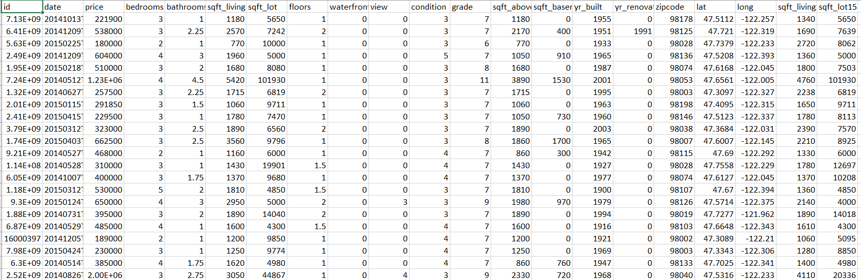
DATASET

Slide 10

HOW IT WORKS?
Collecting data
First step was to collect data we collected data from different sources and merged them together to form our training data set.
Training models
Then we trained the model using machine learning algorithm which is this case is multiple linear regression.
Graph plotting
Based on the generated graphs we predict the cost of the house.

Slide 11
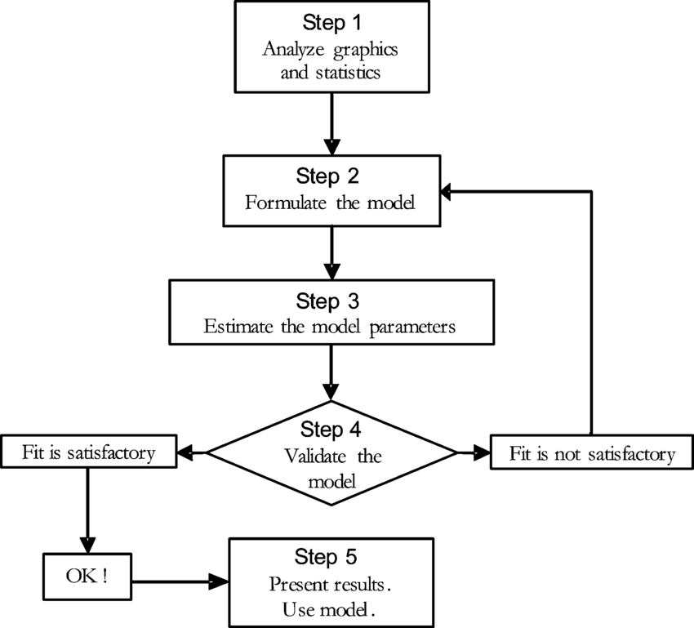
STEPS OF IMPLEMENTATION

Slide 12

DATA CLEANING
The main aim of data cleaning is to identify and remove errors and duplicate data, in order to create a reliable dataset.
The process of data cleaning is done by using a very famous library pandas , numpy , pickle-mixin.
Initially, those features are dropped from our dataset who are not important in deciding the final price.
The rows having a null value in any columns are dropped from our dataset.
The columns having characters as well as integer values are converted into integer values only.

Slide 13
MODEL CREATION
The process of modelling means training a machine learning algorithm to predict the labels from the features.
We have used multiple linear regression algorithm for training and testing of the model
The accuracy rate of our model is 89.26% which is pretty good

Slide 14
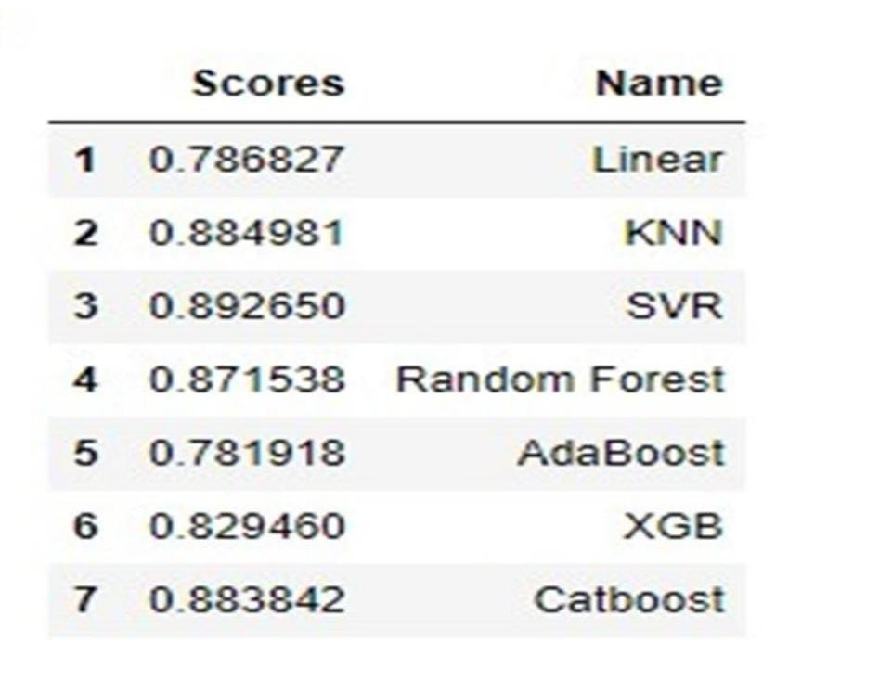
RESULT
We created a function to predict the house price. Our function be like “predict-price(floor, bedroom, bath, year )” When we pass the values into our function ,it will predict house price for us.

Slide 15
OUTPUT

Slide 16
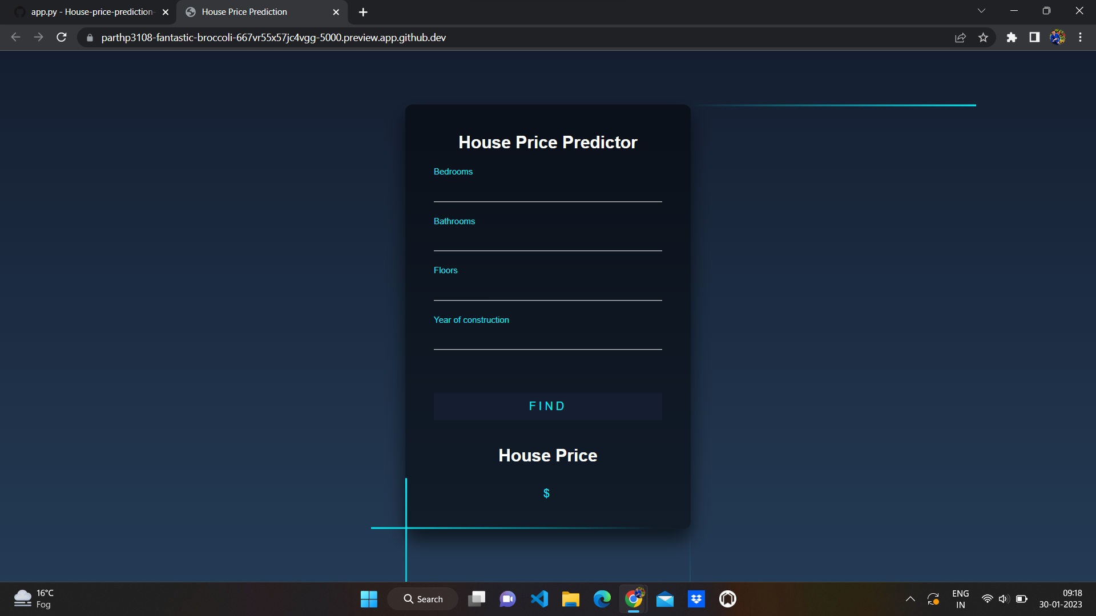
OUTPUT

Slide 17
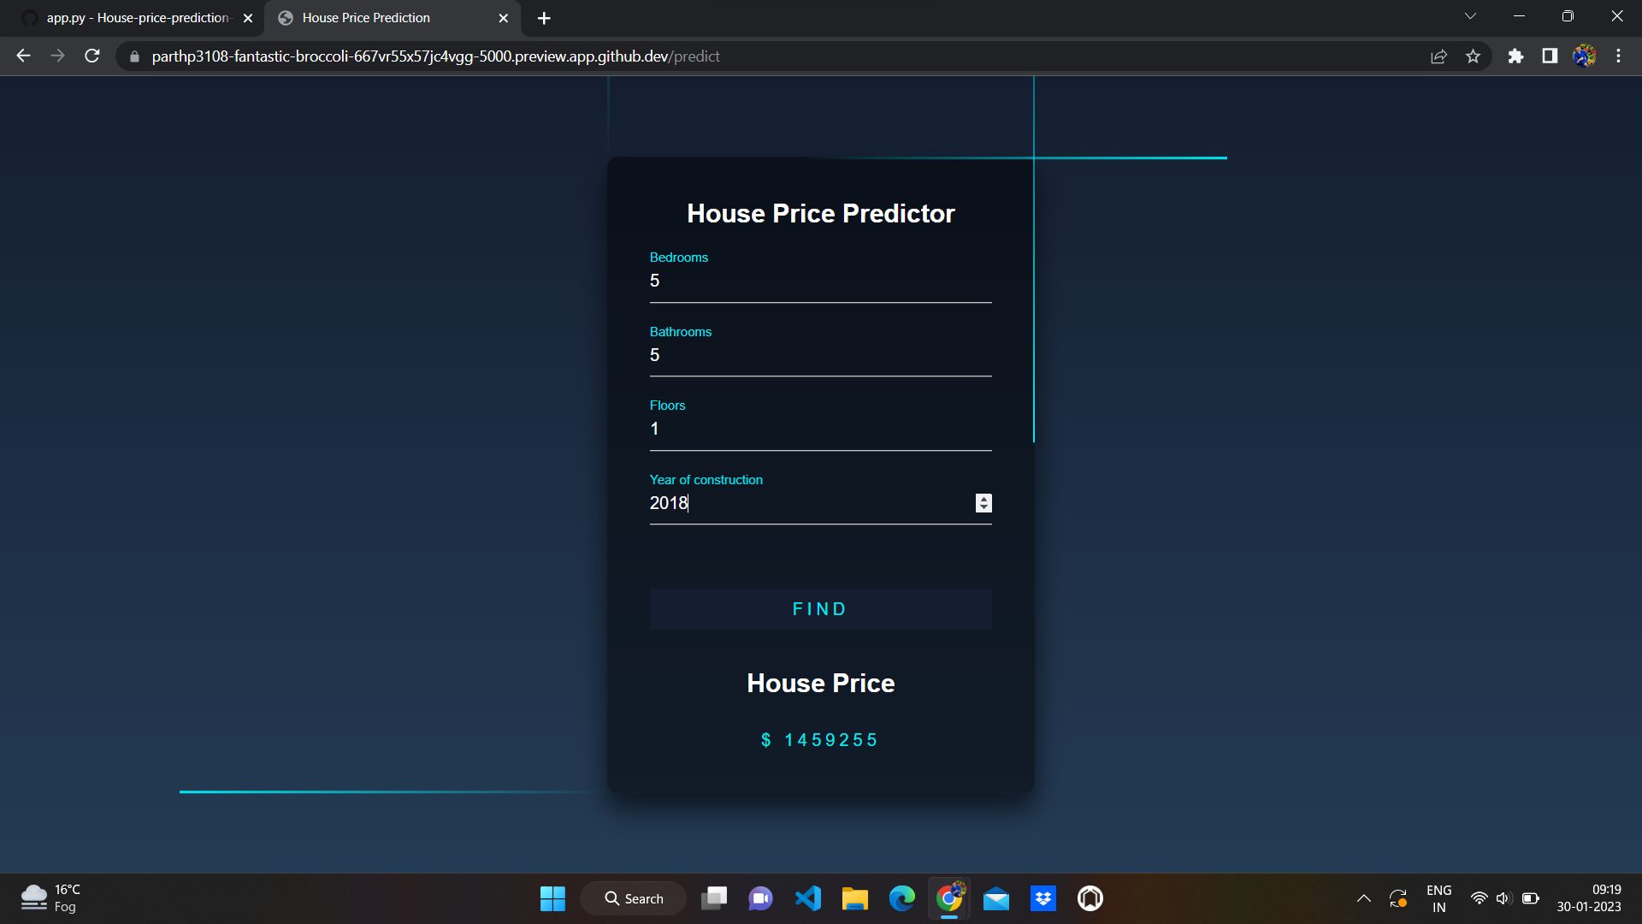

Slide 18
FUTURE SCOPE
Our model had a low RMSE score , but there is still chance for improvement. In real world scenario, we can use such a model to predict house prices. This model should check for new data, once in a month and incorporate them to expand the dataset and produce better results
We can try out other dimensionality reduction techniques like univariate features selection and recursive feature elimination in the initial stages
We can try out other advanced regression techniques, like random forest and Bayesian ridge algorithm ,for prediction, since the data is highly correlated , we should also try Elastic net regression technique

Slide 19
REFRENCES
www.google.com
https://ijarcce.com/upload/2017/december-17/IJARCCE%2016.pdf
www.github.com
www.Kaggle.com
Garriga C., Hedlund A., Tang Y., Wang P, “Regional Science and Urban Economics Rural-urban migration and house prices in China”
Regional Science and Urban Economics (2020), p. 103613, March 2020.

Slide 20
THANK YOU !

